Slide 1
The State of HIPAA in 2023 Safeguarding Our Patients, Protecting Ourselves
3-October-2023

Slide 2
AGENDA
The Threat Environment
Enforcement
Top Challenges – Privacy and Security
The Future

Slide 3
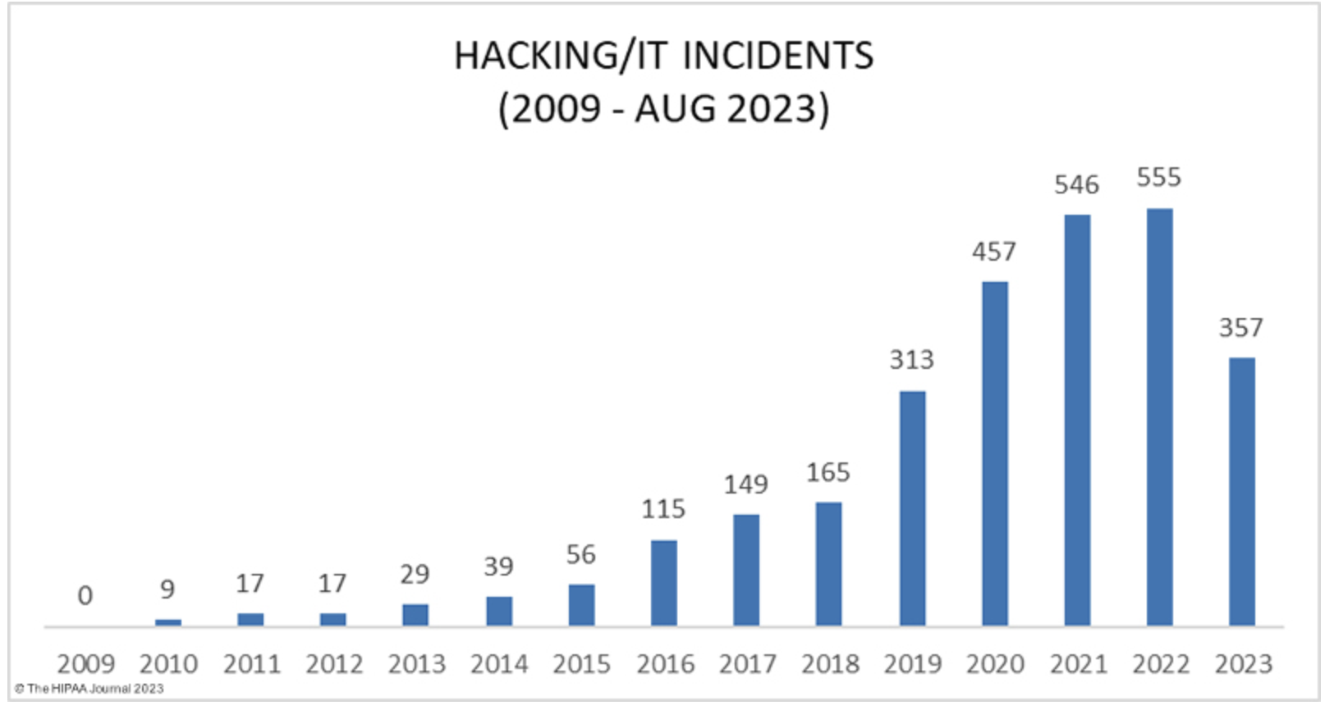
The Threat Environment

Slide 4
Enforcement
Enforcement discretion has ended
OCR has received and investigated a record number of Breach Reports
Decreased OCR enforcement staff
OCR fines + criminal penalties + civil lawsuit settlements

Slide 5
Mitigates fines
Decreases/eliminates length and extent of audit in response to a breach
Mitigates remedies in a HIPAA resolution agreement with HHS

Slide 6
Top Challenges – Privacy & Breach Notification
Timely Access to Records
Insufficient sharing of Privacy Practices
Deficient Privacy Training
Timely Breach Notification
Inadequate Breach Notification content

Slide 7
Top Challenges – Security
Timely Risk Analysis
Insufficient Risk Management
Deficient audit and activity monitoring
User access controls
Deficient Business Associates

Slide 8
Business Associates & BAAs
Supply chain risk
Deficient Risk Analysis
Email awareness
CE to CE BAAs

Slide 9
The Future
Privacy Rule overhaul
Security Rule overhaul
Framework alignment with NIST 171/CSF
More civil claims settlements
Reporting
Notes:
Privacy Rule Changes:
Allowing patients to inspect their PHI in person and take notes or photographs of their PHI.
Changing the maximum time to provide access to PHI from 30 days to 15 days.
Requests by individuals to transfer ePHI to a third party will be limited to the ePHI maintained in an EHR.
Individuals will be permitted to request their PHI be transferred to a personal health application.
States when individuals should be provided with ePHI at no cost.
Covered entities will be required to inform individuals that they have the right to obtain or direct copies of their PHI to a third party when a summary of PHI is offered instead of a copy.
HIPAA-covered entities will be required to post estimated fee schedules on their websites for PHI access and disclosures.
HIPAA-covered entities will be required to provide individualized estimates of the fees for providing an individual with a copy of their own PHI.
Pathway created for individuals to direct the sharing of PHI maintained in an EHR among covered entities.
Healthcare providers and health plans will be required to respond to certain records requests from other covered healthcare providers and health plans, in cases when an individual directs those entities to do so under the HIPAA Right of Access.
The requirement for HIPAA-covered entities to obtain written confirmation that a Notice of Privacy Practices has been provided has been dropped.
Covered entities will be allowed to disclose PHI to avert a threat to health or safety when harm is “seriously and reasonably foreseeable.” The current definition is when harm is “serious and imminent.”
Covered entities will be permitted to make certain uses and disclosures of PHI based on their good faith belief that it is in the best interest of the individual.
The addition of a minimum necessary standard exception for individual-level care coordination and case management uses and disclosures, regardless of whether the activities constitute treatment or health care operations.
The definition of healthcare operations has been broadened to cover care coordination and case management.
The Armed Forces’ permission to use or disclose PHI to all uniformed services has been expanded.
A definition has been added for electronic health records.

Slide 10
Thank you!
Tyler Booker
Director of Advisory Services, Tego
919-792-1748
tbooker@tegodata.com

